Slide 1
Arrays in Java Lecture - 13
Prepared By - Rupali Patil

Slide 2
Contents
Valid variants of main()
Variable Arguments (Varargs) method

Slide 3
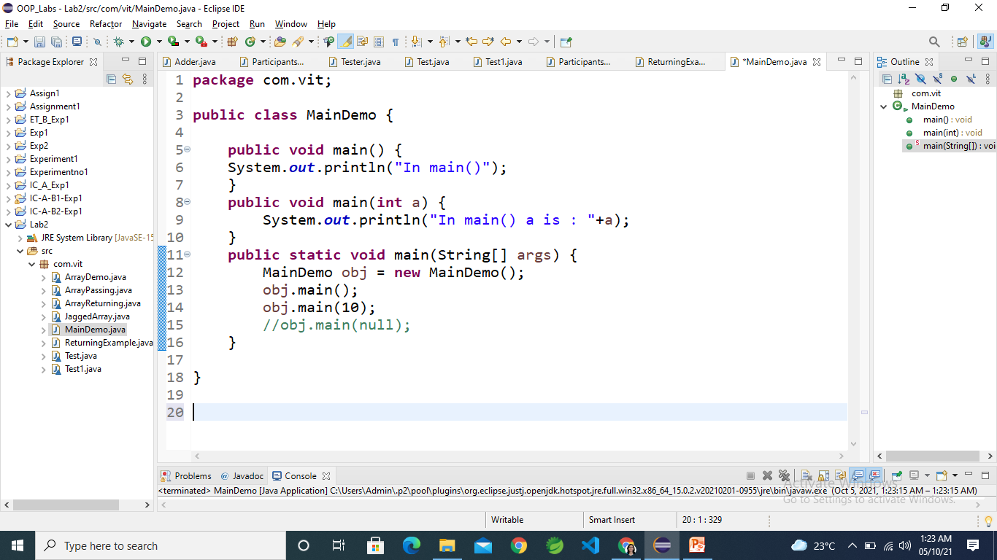
Valid variants of main()
One can overload main() function like ordinary functions in Java.
Class should have one main() function of type:
public static void main(String []args){
}

Slide 4
Variable Arguments (Varargs) method
Java has included a feature that simplifies the creation of methods that need to take a variable number of arguments
It is short-form for variable-length arguments.
A method that takes a variable number of arguments is a varargs method.
A variable-length argument is specified by (…)
Example

Slide 5
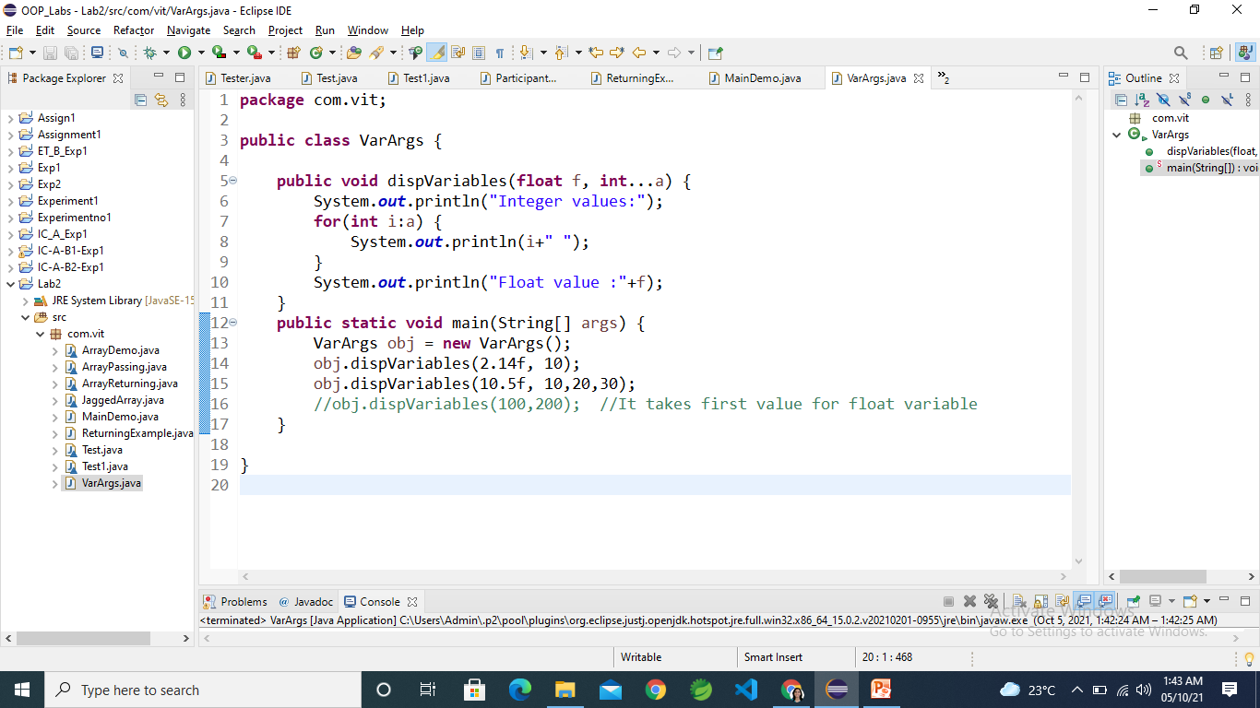
Variable Arguments (Varargs) method
Example

Slide 6
Thank You

